Slide 1

Data Analytics Portfolio
By Thiago Prates Bossardi

Slide 2
Project No. 1:
Analysing bike-sharing data
Cyclistic (fictional name) is a successful bike-share service. The company has a fleet of 5,824 bicycles that are geotracked and locked into a network of 692 stations. The bikes can be unlocked from one station and returned to any other in the system anytime.
The company believes that maximizing the number of annual members will be key for future growth. Rather than creating a marketing campaign that targets all-new customers, the company believes that there is a very good chance to convert casual riders into members. The company notes that casual riders are already aware of the Cyclistic program and have chosen Cyclistic for their mobility needs.

Slide 3
How did I approach the project?
Cleaning and sorting data with excel functions.
Excel pivot tables and pivot charts.
Calculating various descriptive statistics.
I answered questions such as:
What is the gender percentage of the users?
How old are the customers on average?
What is the average length of a trip for customer type?
What is the average trip duration by day of the week?

Slide 4

Cyclistic Bike-share

Slide 5
Summary
Customer profile
How do annual members and casual riders use Cyclistic bikes differrently?
How can Cyclistic use digital media to influence casual riders to become members?

Slide 6
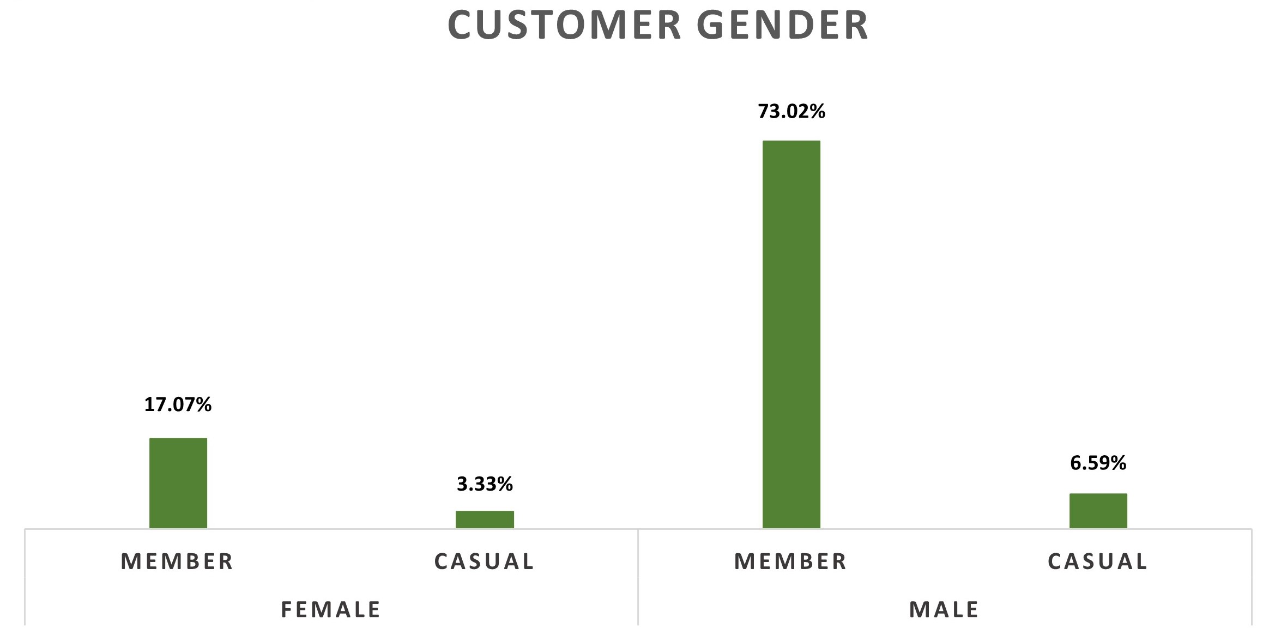
Customer Profile
Here we can see that most of Cyclitstic users are male, accounting for nearly 80% meanwhile female users account for only 20%.

Slide 7
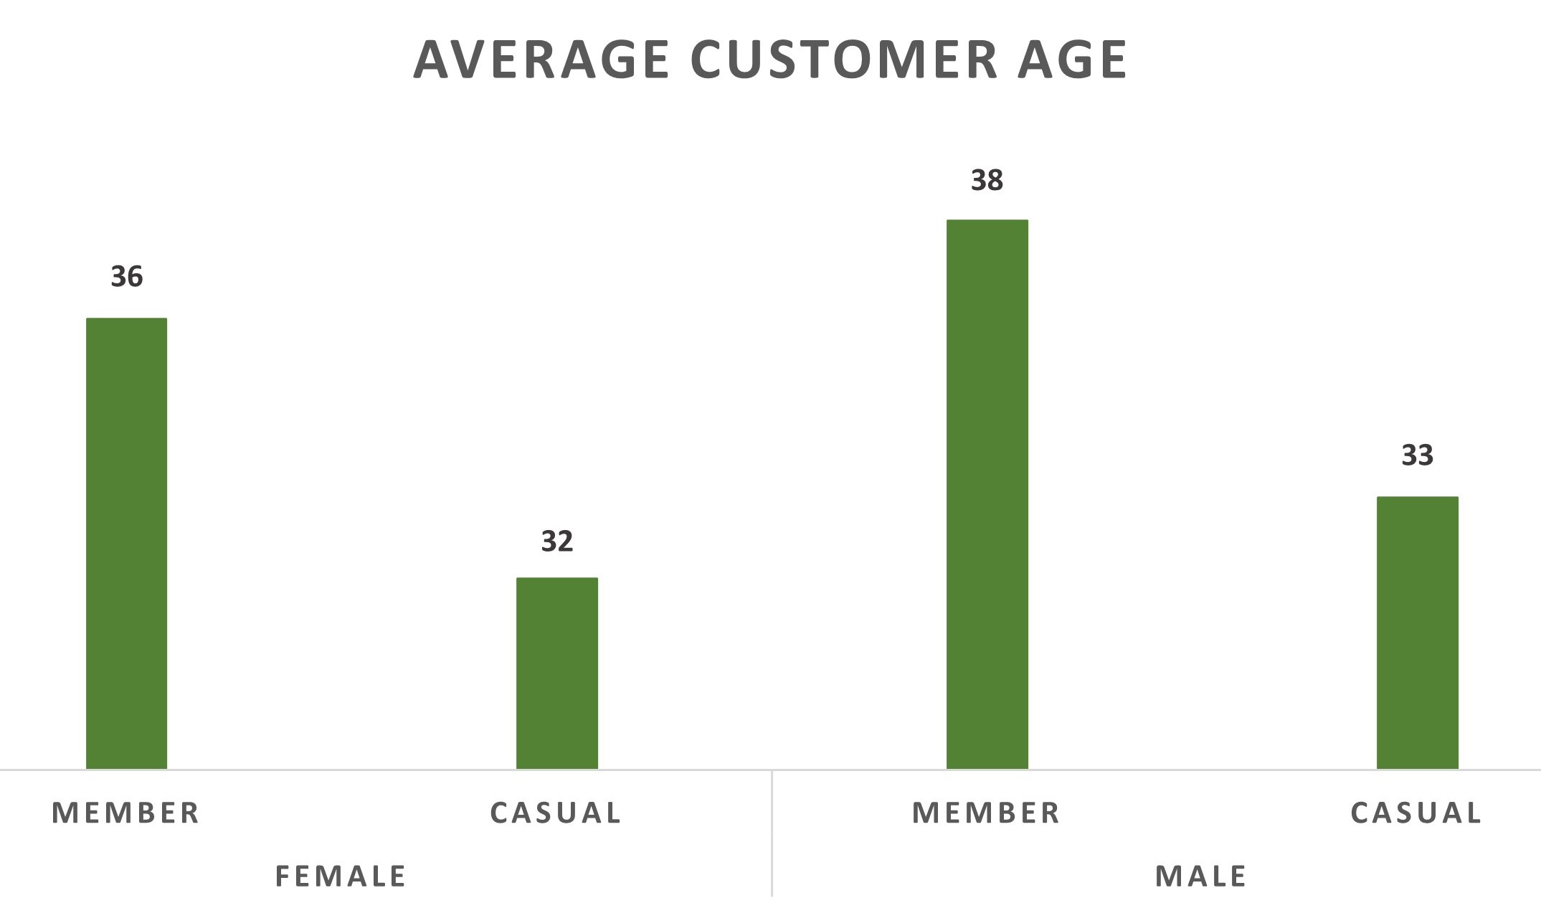
Customer Profile
Another important fact is the average age of the customers ranging from 32 to 38 years old.

Slide 8
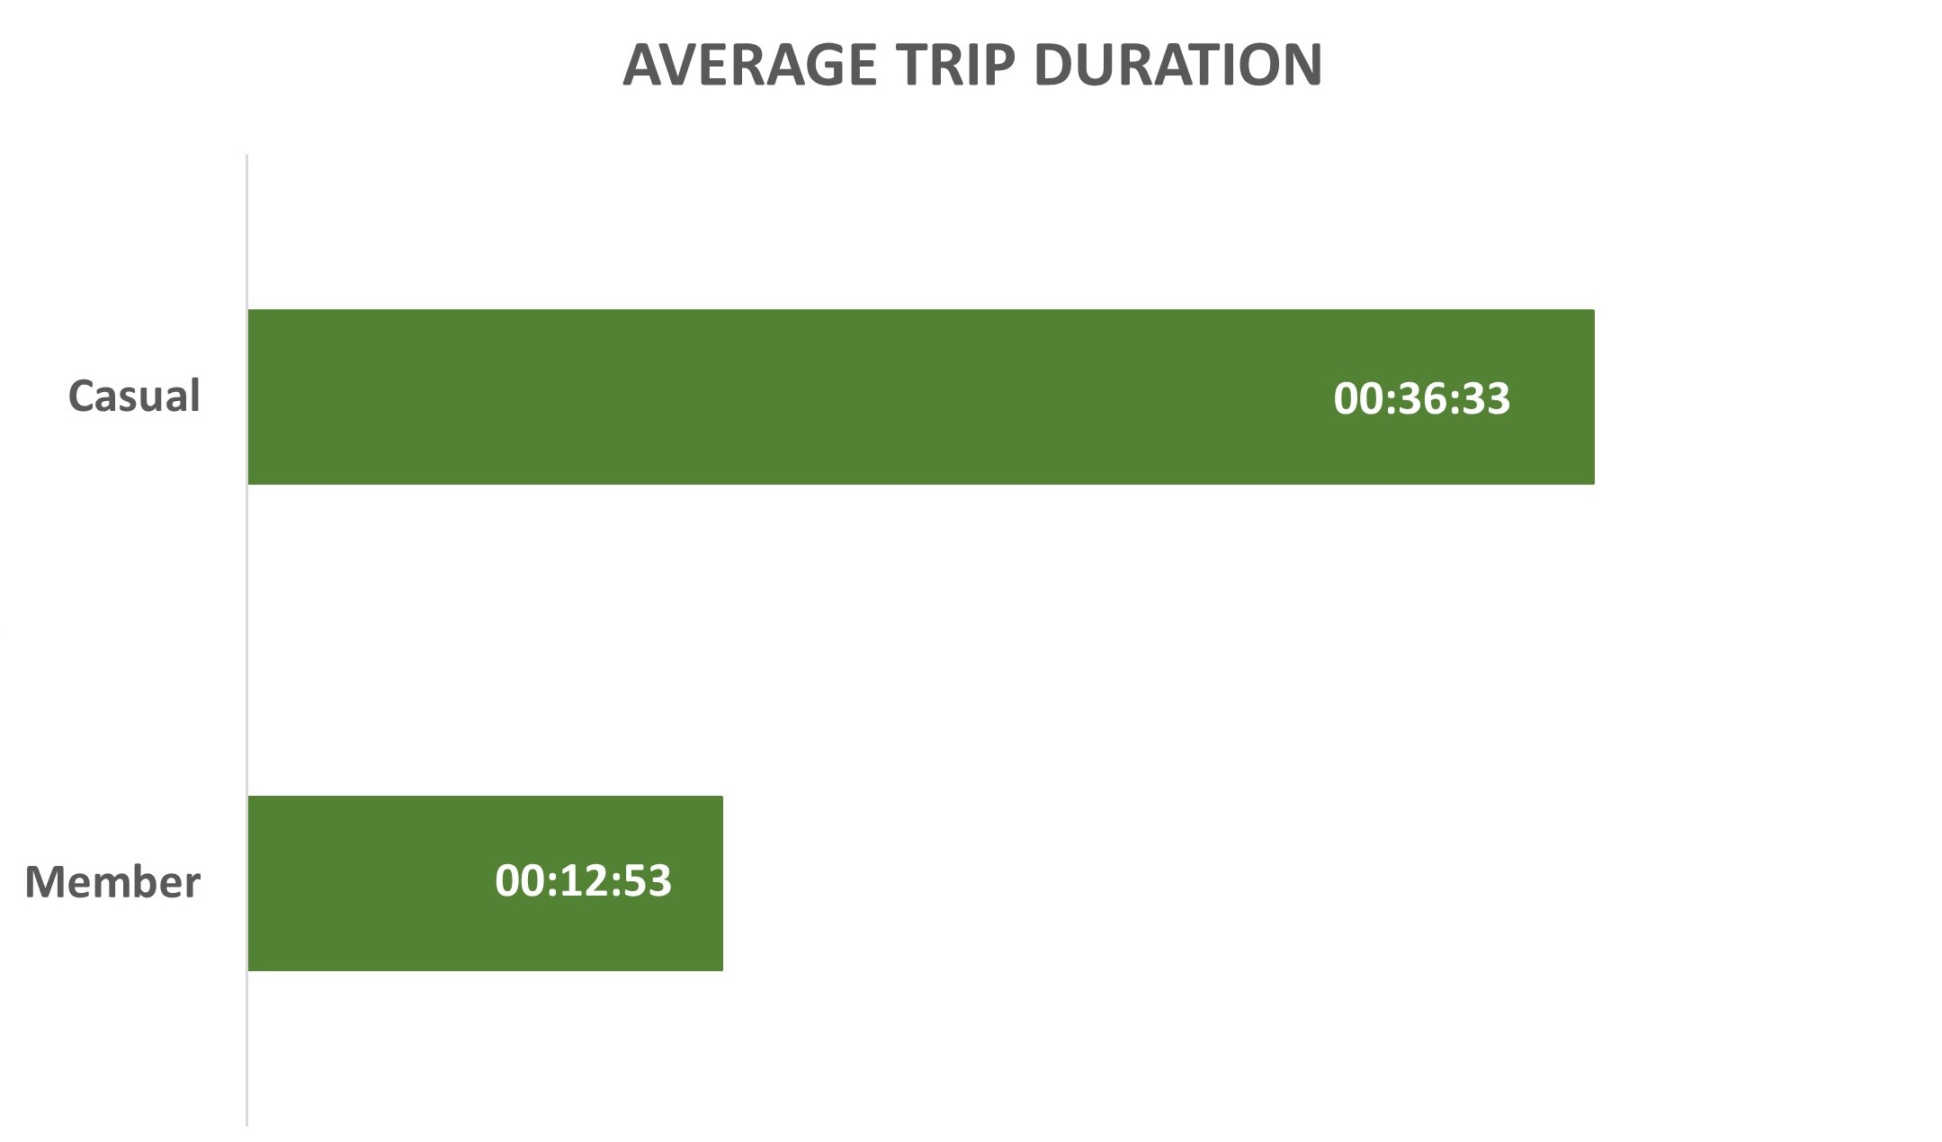
Service Usage Members vs Casual
When thinking about service usage we note that casual customers tend to use the bikes for a longer period than the actual members of Cyclistic.

Slide 9
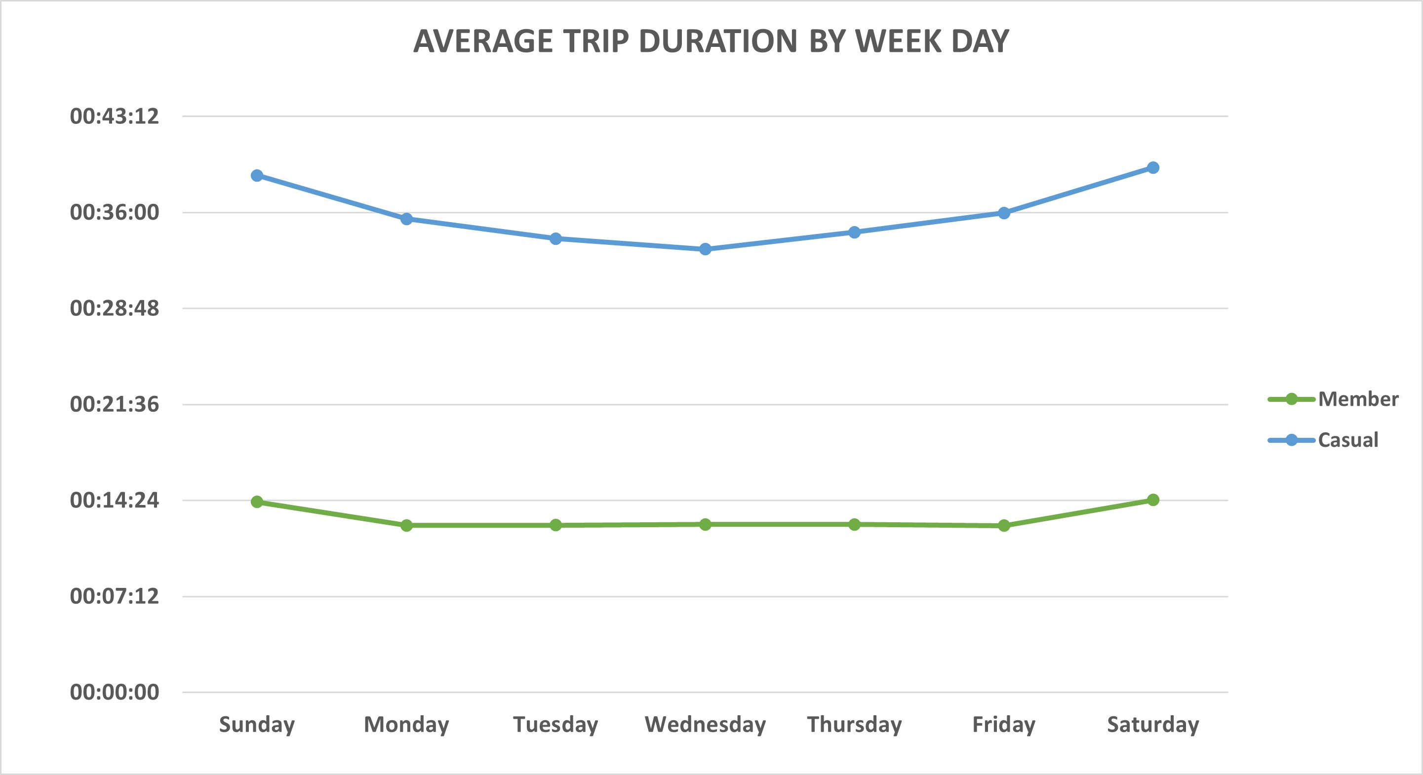
Service Usage Members vs Casual
Looking at this chart we can see a curve in the trip duration of casual customers, showing a preference for using the service on Fridays and Weekends. On the other hand, we see an almost flat line in the annual member daily average usage.
These could mean that while annual members may use the service for commute, the casual customers would use the service for pleasure.

Slide 10
Conclusion
Based on the data collected and analysed, if the company wants to increase the annual members I’d suggest it to focus their advertisement on social media to males and females on the 30’s to 40’s year old group that have used the service of Cyclistic at least once.
Another suggestion is to make some kind of promotion on weekdays to try to increase the service usage by casual customers.

Slide 11
Appendix
This is a personal project, all data utilized in this project is open to the public at the address: https://divvy-tripdata.s3.amazonaws.com/index.html.
The objective of this project is to showcase some abilities in data analyses as part of the author’s portfolio.

